Slide 1


Playing with modalities Part I: Reasoning About Group Polarization
📷 Tanner Mardis
Robert Freiman
Carlos Olarte
Elaine Pimentel
Chris Fermüller

Slide 2


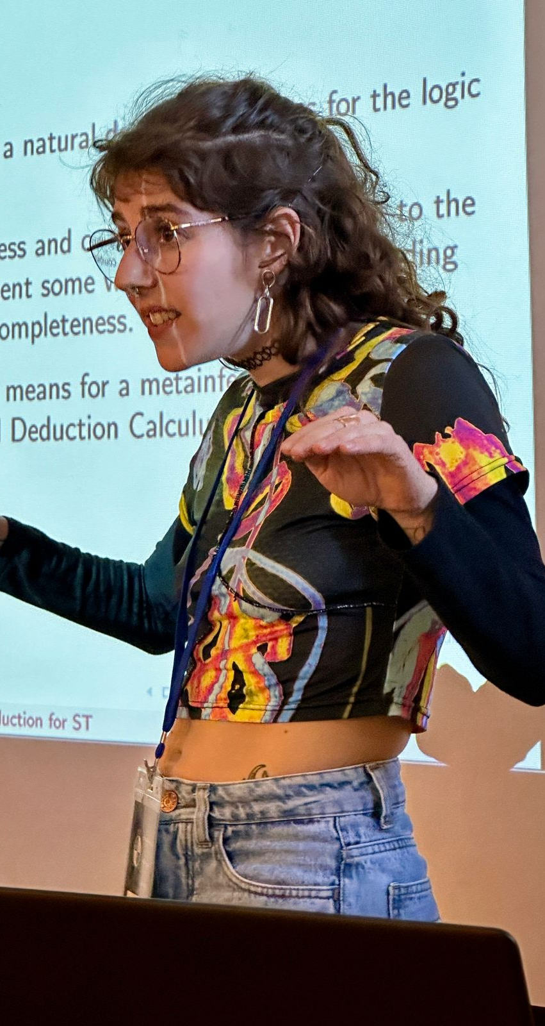
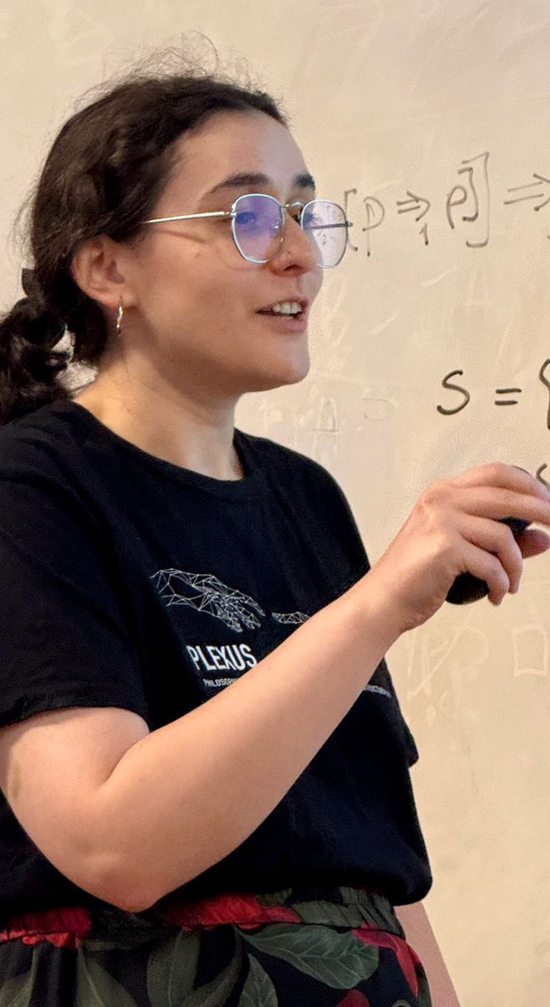
A big THANK YOU!

Slide 3
Semantic Game (truth in a model)
lift
Provability Game
(validity)
extract
Analytic Calculus
Notes:
Unkonventionelle Struktur explizit
Let me start unconventionally, later talk about overview

Slide 4
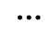
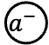
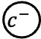
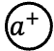
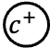
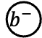
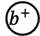
Hintikka‘s Semantic Game
$$a^{+}$$
$$b^{+}$$
$$c^{+}$$
$$⋮$$
$$a^{−}$$
$$b^{−}$$
$$c^{−}$$

Slide 5


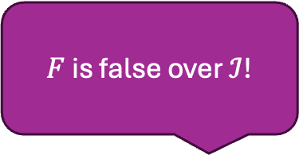


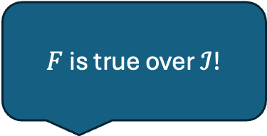

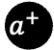
Hintikka‘s Semantic Game
Formula $F=\left[a^{−}∨\left(b^{+}∧c^{−}\right)\right]∨\left[a^{+}∧b^{−}\right]$
Model $ℐ=\left\{a^{+},b^{−},c^{−}\right\}$
$$a^{+}$$
$$b^{+}$$
$$c^{+}$$
$$⋮$$
$$a^{−}$$
$$b^{−}$$
$$c^{−}$$
$F$ is true over $ℐ$!
$F$ is false over $ℐ$!
Proponent
Opponent
Notes:
Negation durch Role Switch erwähnen, aber nicht betrachtet (verbal)

Slide 6
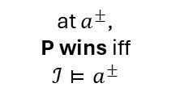
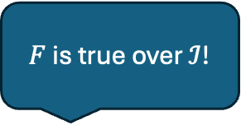



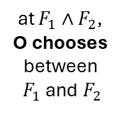
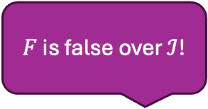
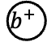
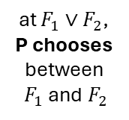
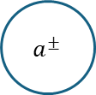
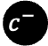
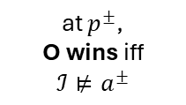
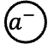

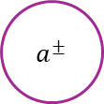
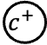
Hintikka‘s Semantic Game
$$a^{+}$$
$$b^{+}$$
$$c^{+}$$
$$a^{−}$$
$$b^{−}$$
$$c^{−}$$
Formula $F=\left[a^{−}∨\left(b^{+}∧c^{−}\right)\right]∨\left[a^{+}∧b^{−}\right]$
Model $ℐ=\left\{a^{+},b^{−},c^{−}\right\}$
$∨$
$∧$
$a^{±}$
$a^{±}$
at $F_{1}∨F_{2}$, P chooses between $F_{1}$ and $F_{2}$
at $F_{1}∧F_{2}$, O chooses between $F_{1}$ and $F_{2}$
at $a^{±}$,
P wins iff $ℐ⊨a^{±}$
at $p^{±}$,
O wins iff $ℐ⊭a^{±}$
$F$ is true over $ℐ$!
$F$ is false over $ℐ$!
Notes:
Formel animation löschen

Slide 7
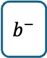
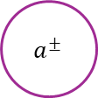

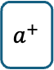
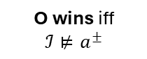
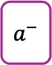
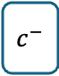


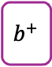
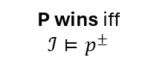
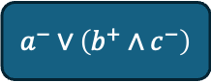
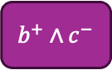

Example
$$a^{+}$$
$$b^{+}$$
$$c^{+}$$
$$a^{−}$$
$$b^{−}$$
$$c^{−}$$
Formula $F=\left[a^{−}∨\left(b^{+}∧c^{−}\right)\right]∨\left[a^{+}∧b^{−}\right]$
Model $ℐ=\left\{a^{+},b^{−},c^{−}\right\}$
$∨$
$\left[a^{−}∨\left(b^{+}∧c^{−}\right)\right]∨\left[a^{+}∧b^{−}\right]$
P chooses
$∧$
$a^{−}∨\left(b^{+}∧c^{−}\right)$
$a^{+}∧b^{−}$
O chooses
$a^{±}$
$a^{−}$
$b^{+}∧c^{−}$
$a^{+}$
$b^{−}$
P wins iff $ℐ⊨p^{±}$
$a^{±}$
$b^{+}$
$c^{−}$
O wins iff $ℐ⊭a^{±}$
Notes:
animation formel löschen (auch nächste Slides?)

Slide 8
Example
$$a^{+}$$
$$b^{+}$$
$$c^{+}$$
$$a^{−}$$
$$b^{−}$$
$$c^{−}$$
Formula $F=\left[a^{−}∨\left(b^{+}∧c^{−}\right)\right]∨\left[a^{+}∧b^{−}\right]$
Model $ℐ=\left\{a^{+},b^{−},c^{−}\right\}$
P has a winning strategy:
$∨$
$\left[a^{−}∨\left(b^{+}∧c^{−}\right)\right]∨\left[a^{+}∧b^{−}\right]$
P chooses
$∧$
$a^{−}∨\left(b^{+}∧c^{−}\right)$
$a^{+}∧b^{−}$
O chooses
$a^{±}$
$a^{−}$
$b^{+}∧c^{−}$
$a^{+}$
$b^{−}$
P wins iff $ℐ⊨p^{±}$
$a^{±}$
$b^{+}$
$c^{−}$
O wins iff $ℐ⊭a^{±}$
Notes:
falsche Formel
dicke Striche

Slide 9
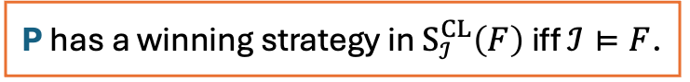
Example
$$a^{+}$$
$$b^{+}$$
$$c^{+}$$
$$a^{−}$$
$$b^{−}$$
$$c^{−}$$
Formula $F=\left[a^{−}∨\left(b^{+}∧c^{−}\right)\right]∨\left[a^{+}∧b^{−}\right]$
Model $ℐ=\left\{a^{+},b^{−},c^{−}\right\}$
P has a winning strategy:
$∨$
$\left[a^{−}∨\left(b^{+}∧c^{−}\right)\right]∨\left[a^{+}∧b^{−}\right]$
P chooses
$∧$
$a^{+}∧b^{−}$
O chooses
$a^{±}$
$a^{+}$
$b^{−}$
P wins iff $ℐ⊨p^{±}$
$a^{±}$
O wins iff $ℐ⊭a^{±}$
P has a winning strategy in $S_{ℐ}^{CL}\left(F\right)$ iff $ℐ⊨F$.
Notes:
Two times theorem box?

Slide 10
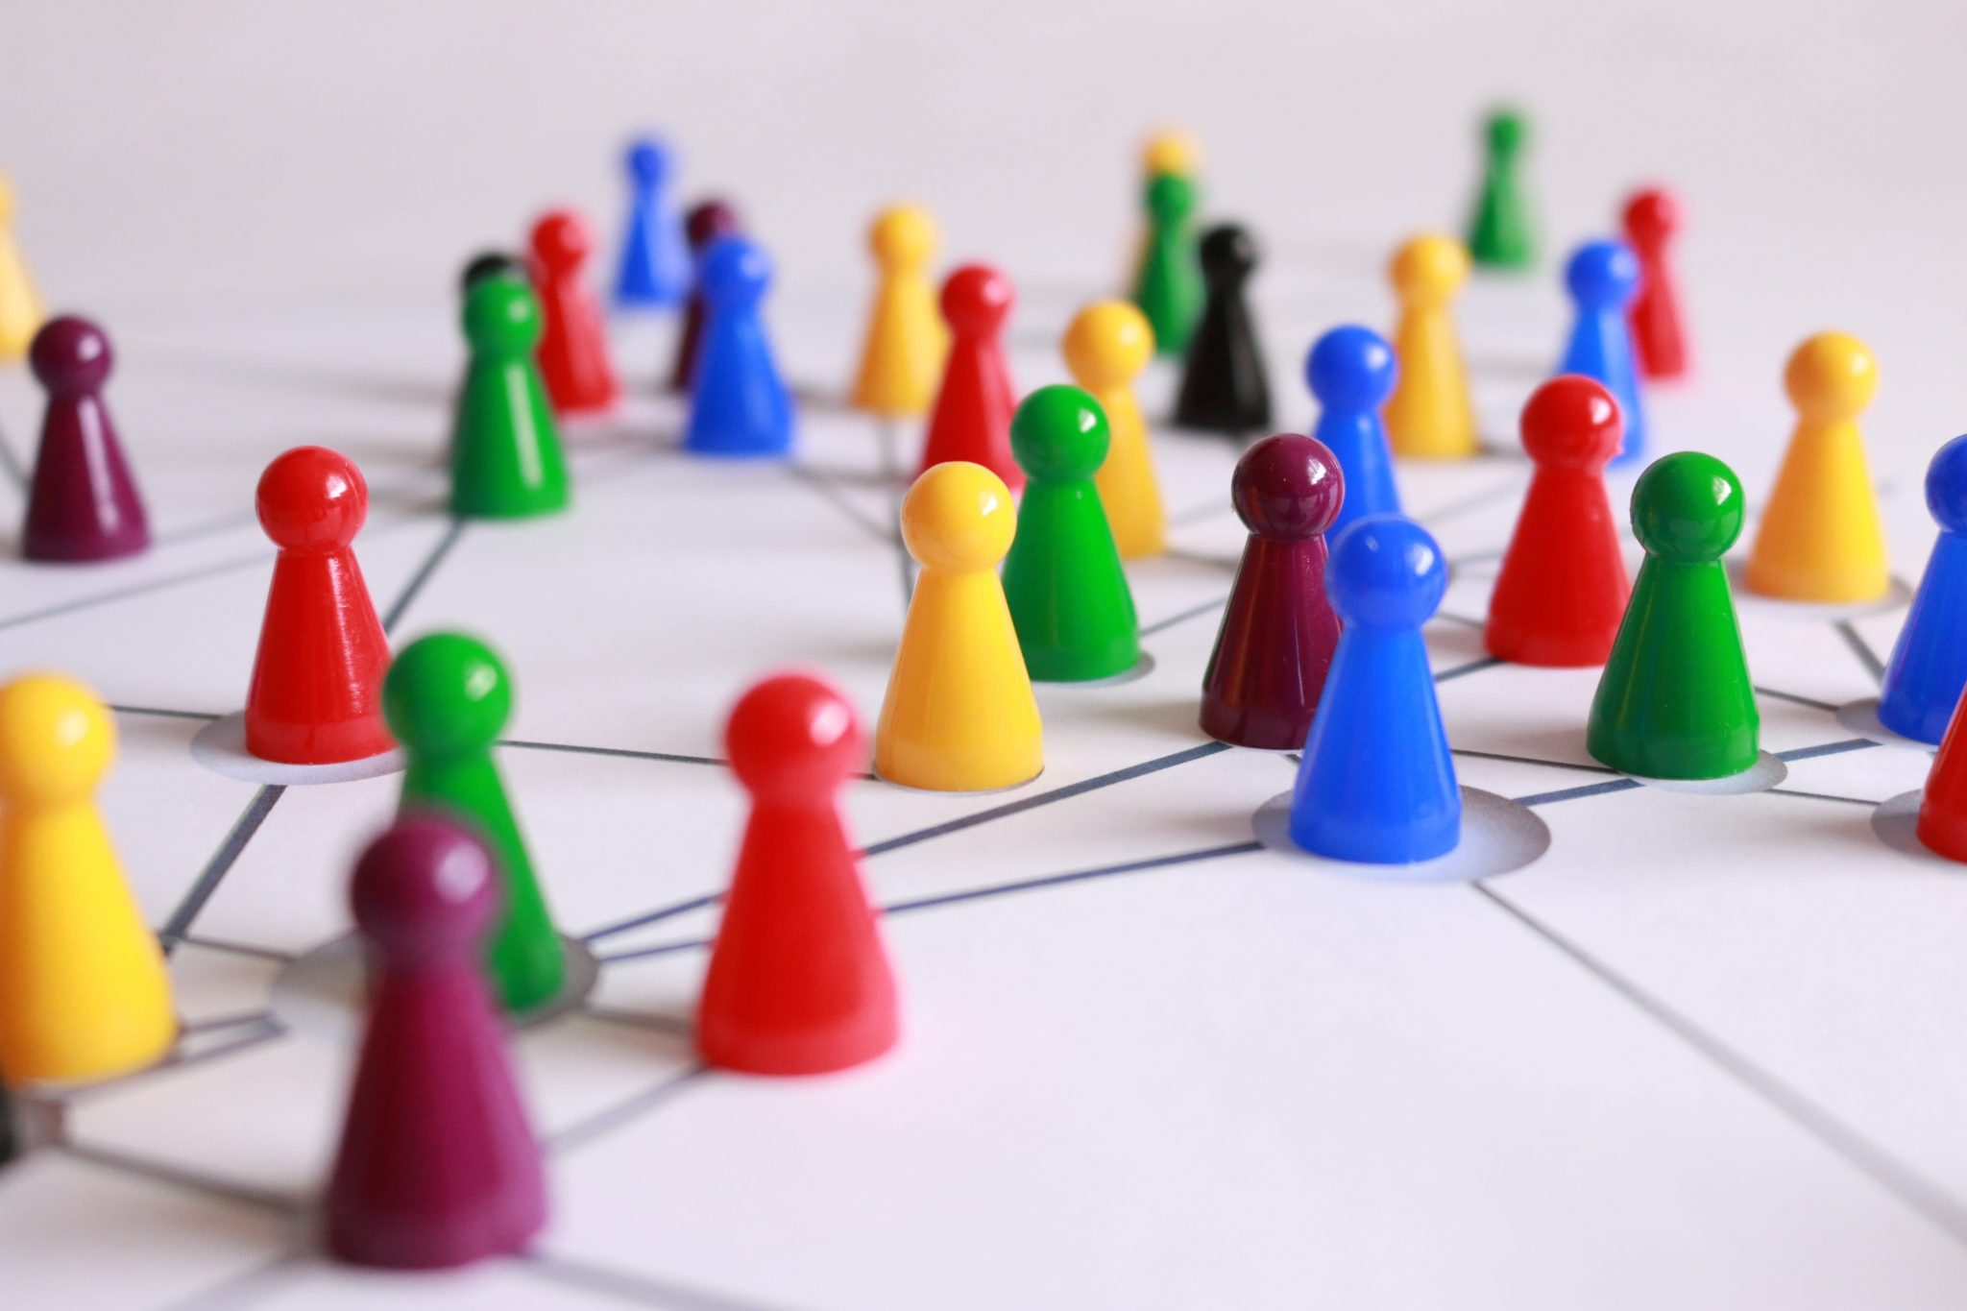
From Semantic Games to Provability Games
Can P play the game such that she wins in every model?
Notes:
Selbe Font in der Überschrift

Slide 11

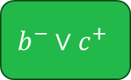
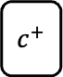
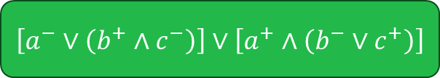


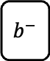
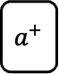
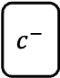


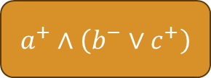
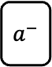
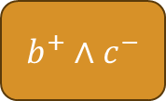
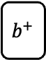
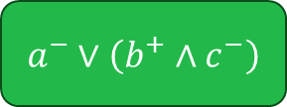

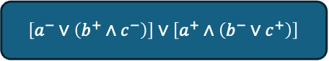
Uniform Strategies?
Can P play the game such that she wins in every model?
$\left[a^{−}∨\left(b^{+}∧c^{−}\right)\right]∨\left[a^{+}∧\left(b^{−}∨c^{+}\right)\right]$
$\left[a^{−}∨\left(b^{+}∧c^{−}\right)\right]∨\left[a^{+}∧\left(b^{−}∨c^{+}\right)\right]$
$\left[a^{−}∨\left(b^{+}∧c^{−}\right)\right]∨\left[a^{+}∧\left(b^{−}∨c^{+}\right)\right]$
$\left[a^{−}∨\left(b^{+}∧c^{−}\right)\right]∨\left[a^{+}∧\left(b^{−}∨c^{+}\right)\right]$
$\left[a^{−}∨\left(b^{+}∧c^{−}\right)\right]∨\left[a^{+}∧\left(b^{−}∨c^{+}\right)\right]$
$a^{−}∨\left(b^{+}∧c^{−}\right)$
$a^{−}∨\left(b^{+}∧c^{−}\right)$
$a^{−}∨\left(b^{+}∧c^{−}\right)$
$a^{−}∨\left(b^{+}∧c^{−}\right)$
$a^{−}∨\left(b^{+}∧c^{−}\right)$
$a^{+}∧\left(b^{−}∨c^{+}\right)$
$a^{+}∧\left(b^{−}∨c^{+}\right)$
$a^{+}∧\left(b^{−}∨c^{+}\right)$
$a^{+}∧\left(b^{−}∨c^{+}\right)$
$a^{+}∧\left(b^{−}∨c^{+}\right)$
$b^{+}∧c^{−}$
$b^{+}∧c^{−}$
$b^{+}∧c^{−}$
$b^{+}∧c^{−}$
$b^{+}∧c^{−}$
$a^{+}$
$a^{+}$
$a^{+}$
$a^{+}$
$a^{+}$
$$b^{−}∨c^{+}$$
$$b^{−}∨c^{+}$$
$$b^{−}∨c^{+}$$
$$b^{−}∨c^{+}$$
$a^{−}$
$$b^{−}∨c^{+}$$
$a^{−}$
$a^{−}$
$a^{−}$
$a^{−}$
$b^{+}$
$b^{+}$
$b^{+}$
$b^{+}$
$b^{+}$
$c^{−}$
$c^{−}$
$c^{−}$
$c^{−}$
$c^{−}$
$b^{−}$
$b^{−}$
$b^{−}$
$b^{−}$
$b^{−}$
$c^{+}$
$c^{+}$
$c^{+}$
$c^{+}$
$c^{+}$

Slide 12
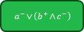
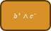























Uniform Strategies?
$\left[a^{−}∨\left(b^{+}∧c^{−}\right)\right]∨\left[a^{+}∧\left(b^{−}∨c^{+}\right)\right]$
$a^{−}∨\left(b^{+}∧c^{−}\right)$
$a^{+}∧\left(b^{−}∨c^{+}\right)$
$a^{−}$
$b^{+}∧c^{−}$
$a^{+}$
$$b^{−}∨c^{+}$$
$b^{+}$
$c^{−}$
$b^{−}$
$c^{+}$
$\left[a^{−}∨\left(b^{+}∧c^{−}\right)\right]∨\left[a^{+}∧\left(b^{−}∨c^{+}\right)\right]$
$\left[a^{−}∨\left(b^{+}∧c^{−}\right)\right]∨\left[a^{+}∧\left(b^{−}∨c^{+}\right)\right]$
$a^{−}∨\left(b^{+}∧c^{−}\right)$
$a^{+}∧\left(b^{−}∨c^{+}\right)$
$a^{−}∨\left(b^{+}∧c^{−}\right)$
$a^{+}∧\left(b^{−}∨c^{+}\right)$
$a^{−}$
$b^{+}∧c^{−}$
$a^{+}$
$$b^{−}∨c^{+}$$
$b^{+}$
$c^{−}$
$b^{−}$
$c^{+}$
$\left[a^{−}∨\left(b^{+}∧c^{−}\right)\right]∨\left[a^{+}∧\left(b^{−}∨c^{+}\right)\right]$
$a^{−}$
$b^{+}∧c^{−}$
$a^{+}$
$$b^{−}∨c^{+}$$
$a^{−}∨\left(b^{+}∧c^{−}\right)$
$a^{+}∧\left(b^{−}∨c^{+}\right)$
$a^{−}$
$b^{+}∧c^{−}$
$a^{+}$
$$b^{−}∨c^{+}$$
$b^{+}$
$c^{−}$
$b^{−}$
$c^{+}$
$b^{+}$
$c^{−}$
$b^{−}$
$c^{+}$
$\left[a^{−}∨\left(b^{+}∧c^{−}\right)\right]∨\left[a^{+}∧\left(b^{−}∨c^{+}\right)\right]$
$a^{−}∨\left(b^{+}∧c^{−}\right)$
$a^{+}∧\left(b^{−}∨c^{+}\right)$
$a^{−}$
$b^{+}∧c^{−}$
$a^{+}$
$$b^{−}∨c^{+}$$
$b^{+}$
$c^{−}$
$b^{−}$
$c^{+}$

Slide 13














Uniform Strategies?
$\left[a^{−}∨\left(b^{+}∧c^{−}\right)\right]∨\left[a^{+}∧\left(b^{−}∨c^{+}\right)\right]$
$a^{−}∨\left(b^{+}∧c^{−}\right)$
$a^{−}$
$\left[a^{−}∨\left(b^{+}∧c^{−}\right)\right]∨\left[a^{+}∧\left(b^{−}∨c^{+}\right)\right]$
$\left[a^{−}∨\left(b^{+}∧c^{−}\right)\right]∨\left[a^{+}∧\left(b^{−}∨c^{+}\right)\right]$
$a^{−}∨\left(b^{+}∧c^{−}\right)$
$a^{−}∨\left(b^{+}∧c^{−}\right)$
$a^{+}∧\left(b^{−}∨c^{+}\right)$
$b^{+}∧c^{−}$
$b^{+}$
$c^{−}$
$\left[a^{−}∨\left(b^{+}∧c^{−}\right)\right]∨\left[a^{+}∧\left(b^{−}∨c^{+}\right)\right]$
$a^{−}$
$b^{+}∧c^{−}$
$a^{+}$
$$b^{−}∨c^{+}$$
$a^{+}∧\left(b^{−}∨c^{+}\right)$
$a^{+}$
$$b^{−}∨c^{+}$$
$b^{+}$
$c^{−}$
$b^{−}$
$c^{+}$
$b^{−}$
$\left[a^{−}∨\left(b^{+}∧c^{−}\right)\right]∨\left[a^{+}∧\left(b^{−}∨c^{+}\right)\right]$
$a^{+}∧\left(b^{−}∨c^{+}\right)$
$a^{+}$
$$b^{−}∨c^{+}$$
$c^{+}$

Slide 14




Uniform Strategies?
$\left[a^{−}∨\left(b^{+}∧c^{−}\right)\right]∨\left[a^{+}∧\left(b^{−}∨c^{+}\right)\right]$
not winning for $ℐ=\left\{a^{+},b^{+},c^{+}\right\}$
$a^{−}∨\left(b^{+}∧c^{−}\right)$
$a^{−}$
$\left[a^{−}∨\left(b^{+}∧c^{−}\right)\right]∨\left[a^{+}∧\left(b^{−}∨c^{+}\right)\right]$
$\left[a^{−}∨\left(b^{+}∧c^{−}\right)\right]∨\left[a^{+}∧\left(b^{−}∨c^{+}\right)\right]$
$a^{−}∨\left(b^{+}∧c^{−}\right)$
not winning for $ℐ=\left\{a^{+},b^{+},c^{+}\right\}$
$a^{−}∨\left(b^{+}∧c^{−}\right)$
$a^{+}∧\left(b^{−}∨c^{+}\right)$
$b^{+}∧c^{−}$
$b^{+}$
$c^{−}$
$\left[a^{−}∨\left(b^{+}∧c^{−}\right)\right]∨\left[a^{+}∧\left(b^{−}∨c^{+}\right)\right]$
$a^{−}$
$b^{+}∧c^{−}$
$a^{+}$
$$b^{−}∨c^{+}$$
$a^{+}∧\left(b^{−}∨c^{+}\right)$
not winning for $ℐ=\left\{a^{−},b^{+},c^{+}\right\}$
$a^{+}$
$$b^{−}∨c^{+}$$
$b^{+}$
$c^{−}$
$b^{−}$
$c^{+}$
$b^{−}$
$\left[a^{−}∨\left(b^{+}∧c^{−}\right)\right]∨\left[a^{+}∧\left(b^{−}∨c^{+}\right)\right]$
$a^{+}∧\left(b^{−}∨c^{+}\right)$
not winning for $ℐ=\left\{a^{−},b^{+},c^{+}\right\}$
$a^{+}$
$$b^{−}∨c^{+}$$
$c^{+}$

Slide 15



The Provability Game
Formula $F=\left[a^{−}∨\left(b^{+}∧c^{−}\right)\right]∨\left[a^{+}∧\left(b^{−}∨c^{+}\right)\right]$
$∨$
P chooses
$B$
P can create backup copies: at $F$, continue with $F∥F$
$∧$
O chooses
$a^{±}$
P wins in $a^{±}$ iff for every model $ℐ$, $ℐ⊨a^{±}$
$a^{±}$
O wins otherwise

Slide 16





The Provability Game
Formula $F=\left[a^{−}∨\left(b^{+}∧c^{−}\right)\right]∨\left[a^{+}∧\left(b^{−}∨c^{+}\right)\right]$
$∨$
P chooses
P can create backup copies: at $F_{1}∥…∥F_{i}∥…∥F_{n}$, continue with
$F_{1}∥…∥F_{i}∥F_{i}∥…∥F_{n}$
$B$
$∧$
O chooses
$Win$
P wins in $a_{1}^{±}∥…∥a_{n}^{±}$ iff for every model $ℐ$, there is some $i$ with $ℐ⊨a_{i}^{±}$
$S$
P is the scheduler
$Win$
O wins otherwise

Slide 17

Example
$\left[a^{−}∨\left(b^{+}∧c^{−}\right)\right]∨\left[a^{+}∧\left(b^{−}∨c^{+}\right)\right]$

Slide 18
Example
$\left[a^{−}∨\left(b^{+}∧c^{−}\right)\right]∨\left[a^{+}∧\left(b^{−}∨c^{+}\right)\right]$
$$\left[a^{−}∨\left(b^{+}∧c^{−}\right)\right]∨\left[a^{+}∧\left(b^{−}∨c^{+}\right)\right]∥\left[a^{−}∨\left(b^{+}∧c^{−}\right)\right]∨\left[a^{+}∧\left(b^{−}∨c^{+}\right)\right]$$

Slide 19
Example
$\left[a^{−}∨\left(b^{+}∧c^{−}\right)\right]∨\left[a^{+}∧\left(b^{−}∨c^{+}\right)\right]$
$$\underline{\left[a^{−}∨\left(b^{+}∧c^{−}\right)\right]∨\left[a^{+}∧\left(b^{−}∨c^{+}\right)\right]}∥\left[a^{−}∨\left(b^{+}∧c^{−}\right)\right]∨\left[a^{+}∧\left(b^{−}∨c^{+}\right)\right]$$
Notes:
Überschriften Größe gleich

Slide 20

Example
$\left[a^{−}∨\left(b^{+}∧c^{−}\right)\right]∨\left[a^{+}∧\left(b^{−}∨c^{+}\right)\right]$
$$\underline{\left[a^{−}∨\left(b^{+}∧c^{−}\right)\right]∨\left[a^{+}∧\left(b^{−}∨c^{+}\right)\right]}∥\left[a^{−}∨\left(b^{+}∧c^{−}\right)\right]∨\left[a^{+}∧\left(b^{−}∨c^{+}\right)\right]$$
$$a^{−}∨\left(b^{+}∧c^{−}\right)∥\left[a^{−}∨\left(b^{+}∧c^{−}\right)\right]∨\left[a^{+}∧\left(b^{−}∨c^{+}\right)\right]$$

Slide 21

Example
$\left[a^{−}∨\left(b^{+}∧c^{−}\right)\right]∨\left[a^{+}∧\left(b^{−}∨c^{+}\right)\right]$
$$\underline{\left[a^{−}∨\left(b^{+}∧c^{−}\right)\right]∨\left[a^{+}∧\left(b^{−}∨c^{+}\right)\right]}∥\left[a^{−}∨\left(b^{+}∧c^{−}\right)\right]∨\left[a^{+}∧\left(b^{−}∨c^{+}\right)\right]$$
$$a^{−}∨\left(b^{+}∧c^{−}\right)∥\underline{\left[a^{−}∨\left(b^{+}∧c^{−}\right)\right]∨\left[a^{+}∧\left(b^{−}∨c^{+}\right)\right]}$$

Slide 22

Example
$\left[a^{−}∨\left(b^{+}∧c^{−}\right)\right]∨\left[a^{+}∧\left(b^{−}∨c^{+}\right)\right]$
$$\underline{\left[a^{−}∨\left(b^{+}∧c^{−}\right)\right]∨\left[a^{+}∧\left(b^{−}∨c^{+}\right)\right]}∥\left[a^{−}∨\left(b^{+}∧c^{−}\right)\right]∨\left[a^{+}∧\left(b^{−}∨c^{+}\right)\right]$$
$$a^{−}∨\left(b^{+}∧c^{−}\right)∥\underline{\left[a^{−}∨\left(b^{+}∧c^{−}\right)\right]∨\left[a^{+}∧\left(b^{−}∨c^{+}\right)\right]}$$
$$a^{−}∨\left(b^{+}∧c^{−}\right)∥\underline{a^{+}∧\left(b^{−}∨c^{+}\right)}$$

Slide 23


Example
$\left[a^{−}∨\left(b^{+}∧c^{−}\right)\right]∨\left[a^{+}∧\left(b^{−}∨c^{+}\right)\right]$
$$\underline{\left[a^{−}∨\left(b^{+}∧c^{−}\right)\right]∨\left[a^{+}∧\left(b^{−}∨c^{+}\right)\right]}∥\left[a^{−}∨\left(b^{+}∧c^{−}\right)\right]∨\left[a^{+}∧\left(b^{−}∨c^{+}\right)\right]$$
$$a^{−}∨\left(b^{+}∧c^{−}\right)∥\underline{\left[a^{−}∨\left(b^{+}∧c^{−}\right)\right]∨\left[a^{+}∧\left(b^{−}∨c^{+}\right)\right]}$$
$$a^{−}∨\left(b^{+}∧c^{−}\right)∥\underline{a^{+}∧\left(b^{−}∨c^{+}\right)}$$
$$\underline{a^{−}∨\left(b^{+}∧c^{−}\right)}∥a^{+}$$
$$\underline{a^{−}∨\left(b^{+}∧c^{−}\right)}∥b^{−}∨c^{+}$$

Slide 24

Example
$\left[a^{−}∨\left(b^{+}∧c^{−}\right)\right]∨\left[a^{+}∧\left(b^{−}∨c^{+}\right)\right]$
$$\underline{\left[a^{−}∨\left(b^{+}∧c^{−}\right)\right]∨\left[a^{+}∧\left(b^{−}∨c^{+}\right)\right]}∥\left[a^{−}∨\left(b^{+}∧c^{−}\right)\right]∨\left[a^{+}∧\left(b^{−}∨c^{+}\right)\right]$$
$$a^{−}∨\left(b^{+}∧c^{−}\right)∥\underline{\left[a^{−}∨\left(b^{+}∧c^{−}\right)\right]∨\left[a^{+}∧\left(b^{−}∨c^{+}\right)\right]}$$
$$a^{−}∨\left(b^{+}∧c^{−}\right)∥\underline{a^{+}∧\left(b^{−}∨c^{+}\right)}$$
$$\underline{a^{−}∨\left(b^{+}∧c^{−}\right)}∥a^{+}$$
$$\underline{a^{−}∨\left(b^{+}∧c^{−}\right)}∥b^{−}∨c^{+}$$
$$a^{−}∥a^{+}$$

Slide 25

Example
$\left[a^{−}∨\left(b^{+}∧c^{−}\right)\right]∨\left[a^{+}∧\left(b^{−}∨c^{+}\right)\right]$
$$\underline{\left[a^{−}∨\left(b^{+}∧c^{−}\right)\right]∨\left[a^{+}∧\left(b^{−}∨c^{+}\right)\right]}∥\left[a^{−}∨\left(b^{+}∧c^{−}\right)\right]∨\left[a^{+}∧\left(b^{−}∨c^{+}\right)\right]$$
$$a^{−}∨\left(b^{+}∧c^{−}\right)∥\underline{\left[a^{−}∨\left(b^{+}∧c^{−}\right)\right]∨\left[a^{+}∧\left(b^{−}∨c^{+}\right)\right]}$$
$$a^{−}∨\left(b^{+}∧c^{−}\right)∥\underline{a^{+}∧\left(b^{−}∨c^{+}\right)}$$
$$\underline{a^{−}∨\left(b^{+}∧c^{−}\right)}∥a^{+}$$
$$\underline{a^{−}∨\left(b^{+}∧c^{−}\right)}∥b^{−}∨c^{+}$$
$$a^{−}∥a^{+}$$
$$\underline{b^{+}∧c^{−}}∥b^{−}∨c^{+}$$

Slide 26


Example
$\left[a^{−}∨\left(b^{+}∧c^{−}\right)\right]∨\left[a^{+}∧\left(b^{−}∨c^{+}\right)\right]$
$$\underline{\left[a^{−}∨\left(b^{+}∧c^{−}\right)\right]∨\left[a^{+}∧\left(b^{−}∨c^{+}\right)\right]}∥\left[a^{−}∨\left(b^{+}∧c^{−}\right)\right]∨\left[a^{+}∧\left(b^{−}∨c^{+}\right)\right]$$
$$a^{−}∨\left(b^{+}∧c^{−}\right)∥\underline{\left[a^{−}∨\left(b^{+}∧c^{−}\right)\right]∨\left[a^{+}∧\left(b^{−}∨c^{+}\right)\right]}$$
$$a^{−}∨\left(b^{+}∧c^{−}\right)∥\underline{a^{+}∧\left(b^{−}∨c^{+}\right)}$$
$$\underline{a^{−}∨\left(b^{+}∧c^{−}\right)}∥a^{+}$$
$$\underline{a^{−}∨\left(b^{+}∧c^{−}\right)}∥b^{−}∨c^{+}$$
$$a^{−}∥a^{+}$$
$$\underline{b^{+}∧c^{−}}∥b^{−}∨c^{+}$$
$$b^{+}∥\underline{b^{−}∨c^{+}}$$
$$c^{−}∥\underline{b^{−}∨c^{+}}$$

Slide 27

Example
$\left[a^{−}∨\left(b^{+}∧c^{−}\right)\right]∨\left[a^{+}∧\left(b^{−}∨c^{+}\right)\right]$
$$\underline{\left[a^{−}∨\left(b^{+}∧c^{−}\right)\right]∨\left[a^{+}∧\left(b^{−}∨c^{+}\right)\right]}∥\left[a^{−}∨\left(b^{+}∧c^{−}\right)\right]∨\left[a^{+}∧\left(b^{−}∨c^{+}\right)\right]$$
$$a^{−}∨\left(b^{+}∧c^{−}\right)∥\underline{\left[a^{−}∨\left(b^{+}∧c^{−}\right)\right]∨\left[a^{+}∧\left(b^{−}∨c^{+}\right)\right]}$$
$$a^{−}∨\left(b^{+}∧c^{−}\right)∥\underline{a^{+}∧\left(b^{−}∨c^{+}\right)}$$
$$\underline{a^{−}∨\left(b^{+}∧c^{−}\right)}∥a^{+}$$
$$\underline{a^{−}∨\left(b^{+}∧c^{−}\right)}∥b^{−}∨c^{+}$$
$$a^{−}∥a^{+}$$
$$\underline{b^{+}∧c^{−}}∥b^{−}∨c^{+}$$
$$b^{+}∥\underline{b^{−}∨c^{+}}$$
$$c^{−}∥\underline{b^{−}∨c^{+}}$$
$$b^{+}∥b^{−}$$

Slide 28

Example
$\left[a^{−}∨\left(b^{+}∧c^{−}\right)\right]∨\left[a^{+}∧\left(b^{−}∨c^{+}\right)\right]$
$$\underline{\left[a^{−}∨\left(b^{+}∧c^{−}\right)\right]∨\left[a^{+}∧\left(b^{−}∨c^{+}\right)\right]}∥\left[a^{−}∨\left(b^{+}∧c^{−}\right)\right]∨\left[a^{+}∧\left(b^{−}∨c^{+}\right)\right]$$
$$a^{−}∨\left(b^{+}∧c^{−}\right)∥\underline{\left[a^{−}∨\left(b^{+}∧c^{−}\right)\right]∨\left[a^{+}∧\left(b^{−}∨c^{+}\right)\right]}$$
$$a^{−}∨\left(b^{+}∧c^{−}\right)∥\underline{a^{+}∧\left(b^{−}∨c^{+}\right)}$$
$$\underline{a^{−}∨\left(b^{+}∧c^{−}\right)}∥a^{+}$$
$$\underline{a^{−}∨\left(b^{+}∧c^{−}\right)}∥b^{−}∨c^{+}$$
$$a^{−}∥a^{+}$$
$$\underline{b^{+}∧c^{−}}∥b^{−}∨c^{+}$$
$$b^{+}∥\underline{b^{−}∨c^{+}}$$
$$c^{−}∥\underline{b^{−}∨c^{+}}$$
$$b^{+}∥b^{−}$$
$$c^{−}∥c^{+}$$

Slide 29


Adequacy
P has wss in $S_{ℐ}\left(F\right)$ for all $ℐ$
P has a ws in $P\left(F\right)$

Slide 30




Adequacy
P has wss in $S_{ℐ}\left(φ\right)$ for all $ℐ$
O has a ws in $S_{ℐ}\left(φ\right)$ for some $ℐ$
extract
extract
P has a ws in $P\left(φ\right)$
O has a ws in $P\left(φ\right)$

Slide 31














Proof Theory
$∨$
$∧$
$B$
$Win$
at $F_{1}∨F_{2}$, P chooses between $F_{1}$ and $F_{2}$
at $F_{1}∧F_{2}$, O chooses between $F_{1}$ and $F_{2}$
P can create backup copies: at $𝒟∥F$, continue with
$𝒟∥F∥F$
P wins in $a_{1}^{±}∥…∥a_{n}^{±}∥b^{+}∥b^{−}$
$$\frac{𝒟∥F_{1}}{𝒟∥F_{1}∨F_{2}}{\left(∨\right)}_{1}$$
$$\frac{\begin{matrix}𝒟∥F_{1} & 𝒟∥F_{2}\end{matrix}}{𝒟∥F_{1}∧F_{2}}\left(∧\right)$$
$$\frac{𝒟∥F∥F}{𝒟∥F}\left(c\right)$$
$a_{1}^{±}∥…∥a_{n}^{±}∥b^{+}∥b^{−}$ (Axiom)
$$\frac{𝒟∥F_{2}}{𝒟∥F_{1}∨F_{2}}{\left(∨\right)}_{2}$$
There is a proof of $F$ iff $F$ is valid in CL.
Notes:
Start: 15min.

Slide 32

Modal Logics
Possibility
Neccessity
Obligation
Time…
Notes:
bis hier: 22:40.
Betonen: zentraler eigenständiger Beitrag zur Diss

Slide 33























Semantic Game
$v$
$$a^{+},b^{+}$$
$w$
$$a^{+},b^{−}$$
$u$
Formula $F=◇(a^{+}∧b^{−})$ + model + world
$$a^{−},b^{−}$$
$◇$
at $w:◇F$, P chooses an $wRv$ to continue with $v:F$
$$w:◇(a^{+}∧b^{−})$$
$□$
at $w:□F$,
O chooses an $wRv$ to continue with $v:F$
$$w:a^{+}∧b^{−}$$
$$v:a^{+}∧b^{−}$$
$∨$
P chooses
$w:a^{−}$
$w:b^{−}$
$v:a^{−}$
$v:b^{−}$
$∧$
O chooses
$w:a^{±}$
P wins iff $ℳ,w⊨a^{±}$
$w:a^{±}$
O wins iff $ℳ,w⊭a^{±}$

Slide 34
Semantic Game
$v$
$$a^{+},b^{+}$$
$w$
$$a^{+},b^{−}$$
$u$
Formula $F=◇(a^{+}∧b^{−})$ + model + world
$$a^{−},b^{−}$$
$◇$
at $w:◇F$, P chooses an $wRv$ to continue with $v:F$
$$w:◇(a^{+}∧b^{−})$$
$□$
at $w:□F$,
O chooses an $wRv$ to continue with $v:F$
$$v:a^{+}∧b^{−}$$
$∨$
P chooses
$v:a^{−}$
$v:b^{−}$
$∧$
O chooses
$w:a^{±}$
P wins iff $ℳ,w⊨a^{±}$
$w:a^{±}$
O wins iff $ℳ,w⊭a^{±}$

Slide 35

Polarisation
Notes:
bis hier: 22:40.
Betonen: zentraler eigenständiger Beitrag zur Diss

Slide 36

Agreement and disagreement relations
+
I have a friend (+): there exists a R+ successor.

Slide 37

Agreement and disagreement relations
-
-
I don’t have friends (duality)

Slide 38


Agreement and disagreement relations
Bob
-
+
Alice
I’m friend of Alice
and enemy of Bob.

Slide 39


Agreement and disagreement relations
Everybody is friend of Alice (global modality)
+
+
+
+
Alice

Slide 40



PNL Logic
holds for agent a whenever 𝜙 holds for some a’s enemy.
holds for agent a whenever 𝜙 holds for some a’s friend.
holds whenever 𝜙 holds for all agents

Slide 41

PNL Logic
holds for agent a whenever 𝜙 holds for some a’s enemy.
holds for agent a whenever 𝜙 holds for some a’s friend.
holds whenever 𝜙 holds for all agents
a R⁺ b: agent a agrees with (is a friend of) agent b
a R⁻ b: agent a disagrees with (is an enemy of) agent b
R⁺ is reflexive
R⁺ and R⁻ are symmetric.
These relations do not overlap

Slide 42
PNL Logic
holds for agent a whenever 𝜙 holds for some a’s enemy.
holds for agent a whenever 𝜙 holds for some a’s friend.
holds whenever 𝜙 holds for all agents
a R⁺ b: agent a agrees with (is a friend of) agent b
a R⁻ b: agent a disagrees with (is an enemy of) agent b
R⁺ is reflexive
R⁺ and R⁻ are symmetric.
These relations do not overlap
Optional axiom: collectively connectedness

Slide 43

PNL Logic
holds for agent a whenever 𝜙 holds for some a’s enemy.
holds for agent a whenever 𝜙 holds for some a’s friend.
holds whenever 𝜙 holds for all agents
a R⁺ b: agent a agrees with (is a friend of) agent b
a R⁻ b: agent a disagrees with (is an enemy of) agent b

Slide 44



Semantic Game (truth in a model)
Proponent
F is true over 𝕄
Opponent
F is false over 𝕄
Model 𝕄
PNL
Semantic Game

Slide 45
Provability Game (validity)
Playing over all models
Proponent
F is true
Opponent
F is false
PNL
Semantic Game
Provability Game

Slide 46

Analytic calculus
F is provable
F is not provable
PNL
Semantic Game
Provability Game
Sequent
Calculus

Slide 47


Our Contributions
Towards automation:
Intended meaning
Dynamics
Satisfiability
Semantic Game
Disjunctive states
Conditions for finiteness
Validity
Automatic procedures
Provability Game
Cut-free
Axioms as rules
Modular (different axioms)
Sequent Calculus

Slide 48
Semantic Game for PNL
Satisfiability : Played over a PNL model

Slide 49
Semantic Game for PNL
Satisfiability : Played over a PNL model
Players claim the truth of a formula

Slide 50


Semantic Game for PNL
Satisfiability : Played over a PNL model
Players claim the truth of a formula
Game states:
My and Your choices and strategies
P: Proponent
O: Opponent

Slide 51

Semantic Game
Conjunction

Slide 52


Semantic Game
Conjunction
YOU

Slide 53

Semantic Game
Conjunction

Slide 54

Semantic Game
Conjunction
ME

Slide 55

Semantic Game
Conjunction
ME

Slide 56

Semantic Game
Diamond

Slide 57
Semantic Game
Diamond
No a-successor, then you win

Slide 58

Semantic Game
Diamond
ME

Slide 59

Semantic Game
Diamond

Slide 60
Semantic Game
Diamond
No a-successor, then I win!

Slide 61

Semantic Game
Diamond
YOU

Slide 62



An example: Balance (stable configurations)

Slide 63

Dynamics: playing the game

Slide 64
Dynamics: playing the game

Slide 65
Dynamics: playing the game

Slide 66
Dynamics: playing the game

Slide 67
Dynamics: playing the game

Slide 68
Dynamics: playing the game

Slide 69
Dynamics: playing the game
I win!

Slide 70

Semantic Game G_{𝕄}
Theorem 1.
I have a winning strategy in 𝕄 for
iff

Slide 71

Semantic Game G_{𝕄}
Theorem 1.
I have a winning strategy in 𝕄 for
iff
2. You have a winning strategy in 𝕄 for
iff

Slide 72

What about validity?
There is no a uniform strategy for winning the game

Slide 73
What about validity?
There is no a uniform strategy for winning the game
Validity/disjunctive game:
Multiset of game states.

Slide 74

What about validity?
There is no a uniform strategy for winning the game
Validity/disjunctive game:
Multiset of game states.
The ability to duplicate states.

Slide 75


What about validity?
There is no a uniform strategy for winning the game
Validity/disjunctive game:
Multiset of game states.
The ability to duplicate states.
,
{
}

Slide 76

What about validity?
There is no a uniform strategy for winning the game
Validity/disjunctive game:
Multiset of game states.
The ability to duplicate states.
The model is relevant “only” in elementary states.
,
{
}
,
{
}

Slide 77
Disjunctive games
Disjunctive game DG(P, i : 𝜙) can be thought of as
Me and You

Slide 78
Disjunctive games
Disjunctive game DG(P, i : 𝜙) can be thought of as
Me and You
playing all semantic games G(P, i : 𝜙)

Slide 79
Disjunctive games
Disjunctive game DG(P, i : 𝜙) can be thought of as
Me and You
playing all semantic games G(P, i : 𝜙)
over all PNL-models 𝕄

Slide 80
Disjunctive games
Disjunctive game DG(P, i : 𝜙) can be thought of as
Me and You
playing all semantic games G(P, i : 𝜙)
over all PNL-models 𝕄
Winning condition: I win (and you lose) if for every PNL model there is an elementary game state where I win the semantics game.

Slide 81
Adequacy
Theorem 2
I have a winning strategy for the disjunctive game DG(F) iff F is valid.

Slide 82

A proof system
Left/Right Opponent/Proponent

Slide 83

A proof system
Your choices: branches
My choices: decision

Slide 84

A proof system
Disjunctive games: contraction

Slide 85


A proof system
Fresh nominals (your best strategy)

Slide 86




A proof system
Frame axioms: Relational Rules

Slide 87


A proof system: Example
Collective connectedness

Slide 88


A proof system
Theorem 3
I have a winning strategy for the disjunctive game DG( ) iff
is provable in DS.
Theorem 4
The following rule is admissible

Slide 89

Open questions:
Intuitionistic modal logic
Other substructural variants (like CK)

Slide 90


In the center of discussion:
Maria Osório Costa

